Slide 1
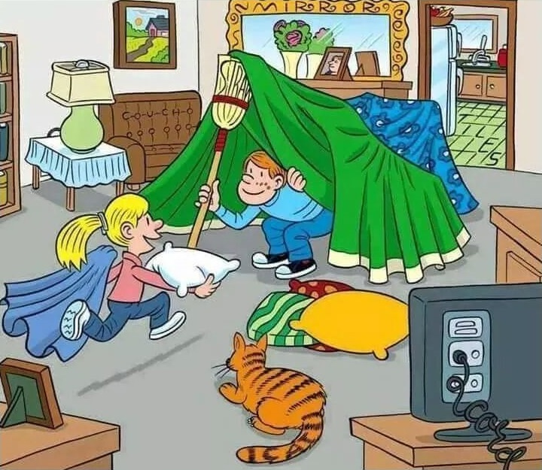
While we wait, find the six words !!!Do not spoil it for other
We will start 5 min past the start time
Send me in chat
your student ID as a private message to mark your attendance
Notes:
Cat, straw, tiles, mirror, couch, cord

Slide 2
How is everyone this week?
How did the Quiz go ?
"I can't work at home, I just can't get out of bed, I feel lazy and cannot do my work"
"I need a lot more structure than I usually did to get going"
The aim for this semester is to teach you C++, data structures and their algoritms
The plan has been laid out in the subject outline each week set the objective to do revisions and practice to be ready for next week lecture and tutorial
It is a good idea is to try and plan your day the night before
How did your week go ?

Slide 3
Tutorial Week 2 && Week 3 Summary
Can you remember what we talked about ?
What did we cover ?

Slide 4
Week 4 topics
Destructors
Sequence containers
Container
adaptors
Templates
Vectors
Iterators

Slide 5
Week 4 topics
Destructors
Vectors & Contrainer Adaptor
Template
Iterator
Some big O

Slide 6
C++
Destructors
JAVA
Container
adaptors
Constructors
new
Delete
Sequence containers
Templates
Iterators

Slide 7
Learning
C++
Templates
Setters
Data structures
Getters
Object Oriented
Constructors
Destructors
Java
Getters
Setters
It is easier to remember something
When you have been reminded of it
Generics
Constructors
In this course we are teaching you C++
This includes its limitation and differences
Object Oriented

Slide 8
C++
http://www.cplusplus.com/reference/
https://stackoverflow.com/
https://www.geeksforgeeks.org/

